Slide 1
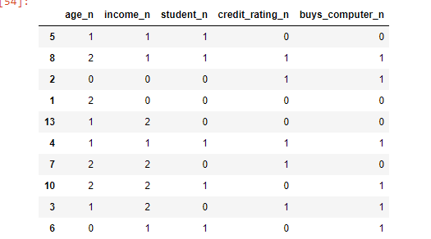
Training Data

Slide 2
